Slide 1
Searches and Sorts

Slide 2
Linear Search
Also called sequential search
Visits each array until it finds a match or reaches the end
Number of visits for a linear search of an array of n elements:
The average search visits n/2 elements
The maximum visits is n
A linear search locates a value in an array in O(n) steps

Slide 3
Binary Search
Locates a value in a sorted array by
Determining whether the value occurs in the first or second half
Then repeating the search in one of the halves
O(log₂ n) – may see this written lg n
What is the requirement to support this search?

Slide 4
Selection Sort
Find the smallest item in the list
Move to front of list (swap places)
Go through remainder of the list until all numbers sorted

Slide 5
Selection Sort Timing
n | milliseconds
10,000 | 33
20,000 | 119
30,000 | 224
40,000 | 407
50,000 | 643
60,000 | 929
600,000 | 89,519

Slide 6
Big-Oh
Determine the number of visits
For Selection Sort, the number of visits is O(n²)
Multiplying the number of elements in an array by 2 multiplies the processing time by 4
Big-Oh notation “f(n) = O(g(n))” expresses that f grows no faster than g
To convert to big-Oh notation: Locate fastest-growing term, and ignore constant coefficient

Slide 7
Algorithm Analysis
Count the number of operations carried out
Count operations to go through n elements
Count operations to go through n-1 elements and so forth
Sum above
Locate the fastest growing number
Ignore coefficient and other terms

Slide 8
Selection Sort Performance Analysis
In an array of size n, count how many times an array element is visited
To find the smallest, visit n elements + 2 visits for the swap
To find the next smallest, visit (n - 1) elements + 2 visits for the swap
The last term is 2 elements visited to find the smallest + 2 visits for the swap
The number of visits:
n + 2 + (n - 1) + 2 + (n - 2) + 2 + ...+ 2 + 2
This can be simplified to n² /2 + 5n/2 - 3
5n/2 - 3 is small compared to n² /2 — so let’s ignore it
Also ignore the 1/2 — it cancels out when comparing ratios
Big Oh
n²

Slide 9
Walkthrough
3 1 2 min = 0
Index2 = 1 pos = 0
Index1 < min
1 < 3 pos = 1
2 < 1
Pos = 1
ChangeNum
Temp = 1
array(min) = array(0)
3 3 2
Array(index) = temp
1 3 2
Second outer loop index = 1
Pos = 1 index2 = 2
Array(pos) = 3
If array (index)22< array(pos)
2 < 3
Pos = 2

Slide 10
Analysis
Why is Selection Sort an n² algorithm?
Loop within loop traversing all elements in array

Slide 11
Insertion Sort
Assume that the subset is already sorted.
Divide into a 1 element array
Look at the next element
If comes before, insert in front
If not insert in sub-array in sorted location
Notes:
Start here

Slide 12
Insertion Sort
Start with a list of 1
Loop
Assign value at new index to temp
Start with the index value
If less than one below, assign one below to value
Repeat above until false or index = 0
Assign temp to indexed position

Slide 13
Analysis of Insertion Sort
Oh is n²

Slide 14
Merge Sort
Sorts an array by
Cutting the array in half
Recursively sorting each half
Merging the sorted halves
Dramatically faster than the selection sort

Slide 15

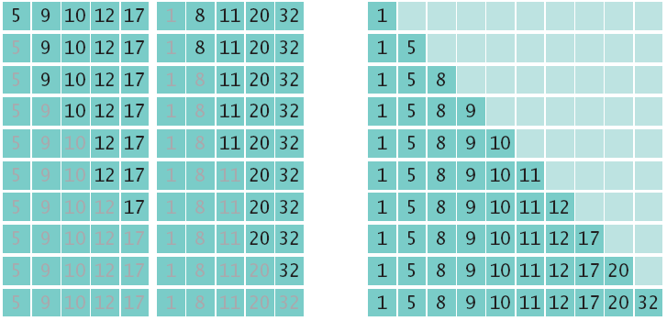
Merge Sort Example
Divide an array in half and sort each half
Merge the two sorted arrays into a single sorted array

Slide 16
Merge Sort Analysis
In an array of size n, count how many times an array element is visited
Assume n is a power of 2: n = 2^{m}
Calculate the number of visits to create the two sub-arrays and then merge the two sorted arrays
3 visits to merge each element or 3n visits
2n visits to create the two sub-arrays
total of 5n visits

Slide 17
Merge Sort Analysis
Let T(n) denote the number of visits to sort an array of n elements then
T(n) = T(n/2) + T(n/2) + 5n or
T(n) = 2T(n/2) + 5n
The visits for an array of size n/2 is:
T(n/2) = 2T(n/4) + 5n/2
So T(n) = 2 × 2T(n/4) +5n + 5n
The visits for an array of size n/4 is:
T(n/4) = 2T(n/8) + 5n/4
So T(n) = 2 × 2 × 2T(n/8) + 5n + 5n + 5n

Slide 18
Merge Sort Analysis
Repeating the process k times:
T(n) = 2 ^{k}T(n/2^{k}) +5nk
Since n = 2^{m}, when k=m: T(n) = 2^{m}T(n/2^{m}) +5nm
T(n) = nT(1) +5nm
T(n) = n + 5nlog₂(n)

Slide 19
Merge Sort Analysis
To establish growth order
Drop the lower-order term n
Drop the constant factor 5
Drop the base of the logarithm since all logarithms are related by a constant factor
We are left with n log₂(n)
Using big-Oh notation: Number of visits is O(nlog₂(n))

Slide 20
Merge Sort vs Selection Sort
Selection sort is an O(n²) algorithm
Merge sort is an O(nlog₂(n)) algorithm
The nlog₂(n) function grows much more slowly than n²

Slide 21
Merge Sort Dance
https://www.youtube.com/watch?v=XaqR3G_NVoo

Slide 22
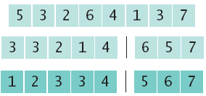
Quick Sort
Divide and conquer
Partition the range
Sort each partition

Slide 23
Quick Sort
No temporary array required to hold and merge items
Based on a divide and conquer algorithm
Recursive algorithm

Slide 24
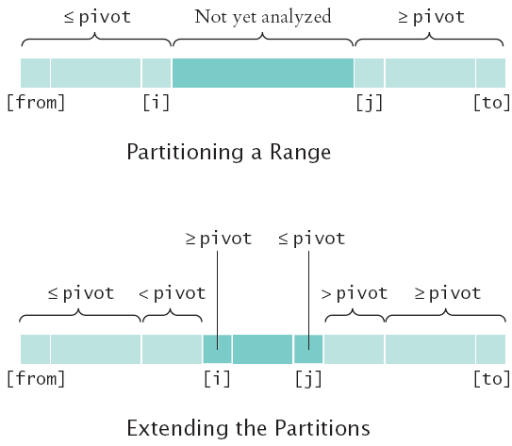
Quick Sort

Slide 25
Quick Sort dance
https://www.youtube.com/watch?v=ywWBy6J5gz8

Slide 26
Quick Sort
nlog₂(n)

Slide 27
Next
IC7 due July 10
HW3 due July 12
Test 2
Take home opens tonight – due next Tuseday
In class coding portion
Test 2 Coding July 17
Project due July 15
IC8 due July 19
Final coding July 24

